Slide 1
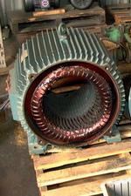

Slide 2
X
out of page
Z
I_{CD} into page
rotor
I_{stator}
rotation
axis
stator
I_{AB} into page

Slide 3
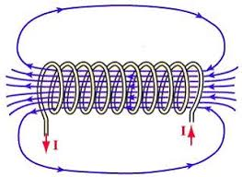
D
Y
A
rotor coil
X
Z
C
B
stator
rotor

Slide 4
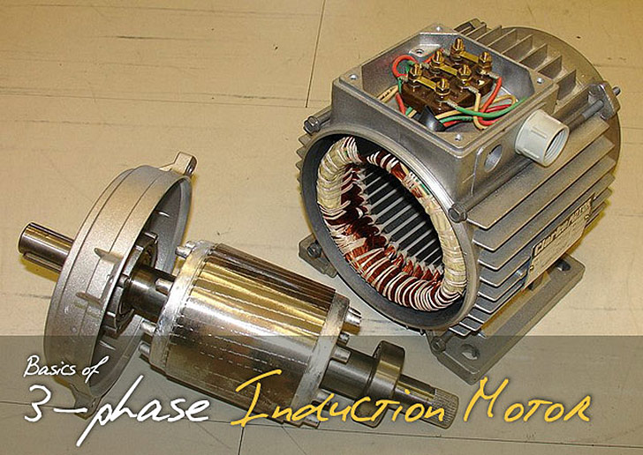
stator
rotor

Slide 5
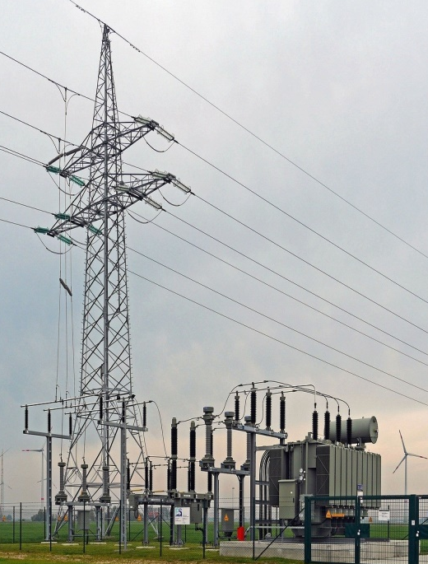

Slide 6
primary
secondary
input
output
laminated soft iron core

Slide 8
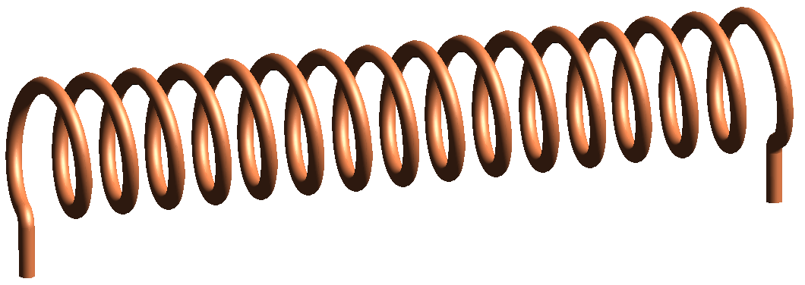
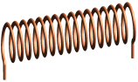
primary
secondary
V
switch closed
switch opened

Slide 9
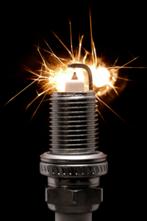
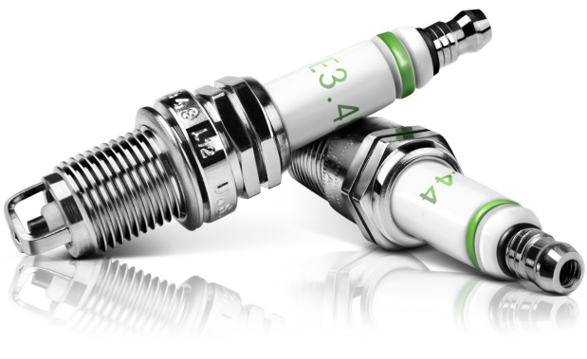
sparking due to very high induced voltages

Slide 10
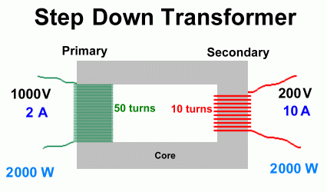
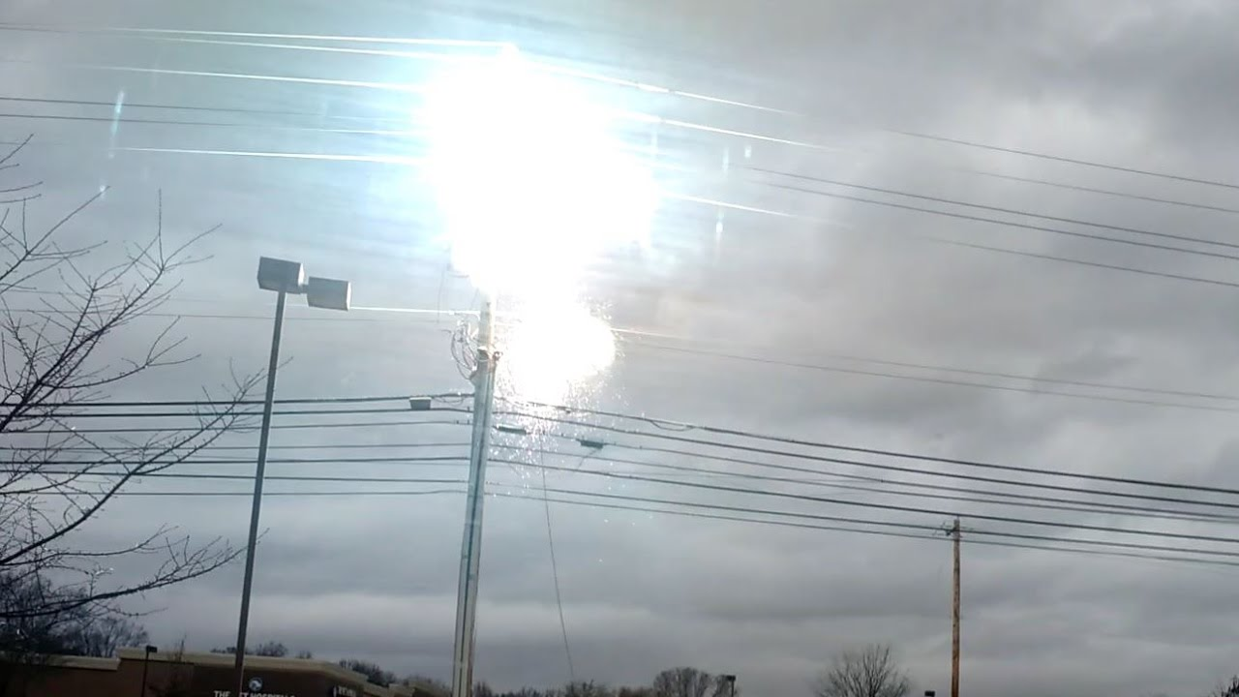
primary
secondary
1000 V
2 A
200 V
10 A
soft iron core
2000 W
2000 W
arcing at a step-down transformer

Slide 11
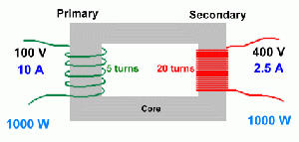
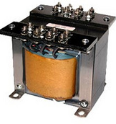
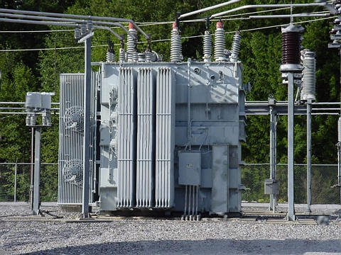
primary
secondary
100 V
20 A
10 turns
500 V
4 A
50 turns
soft iron core
2000 W
2000 W

Slide 12
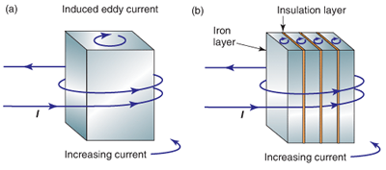
induced eddy current
eddy current cause a heating effect
I
increasing current
insulation layer
iron layer
increasing current
laminations reduce magnitude of eddy currents
⇒ less ohmic heating ( I ² R )

Slide 13
400
300
200
100
potential difference [V]
0
-100
-200
-300
-400
0 10 20 30 40 50 60 70 80
time [ms]

Slide 14
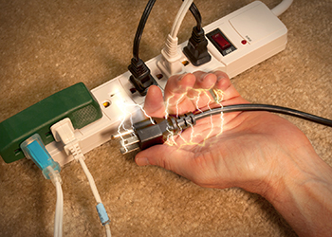

Many people have died by electrocution when contacting the active wire.

Slide 15


Slide 16
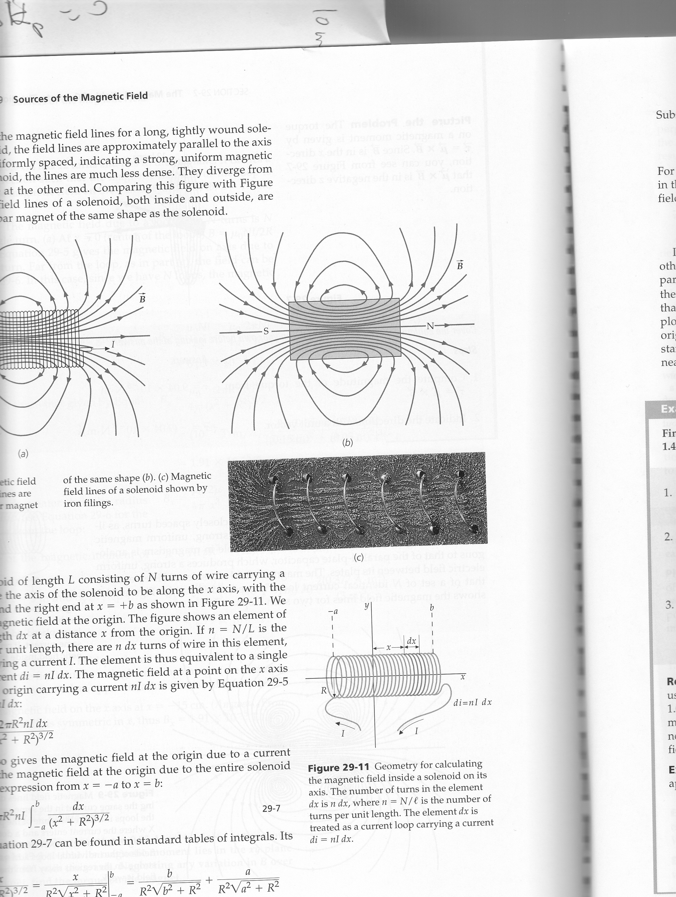
strong field:
high density of B-lines
S
N
S
N
weak field:
low density of B-lines
compass needles / magnets
align along B-field

Slide 17
N
S
the magnetic field in the region
between the poles is nearly uniform

Slide 18
direction of B-field given by right hand rule
R
current I into page
B
B
I
R
B-field increases with increasing I
B-field decreases with increasing R

Slide 19
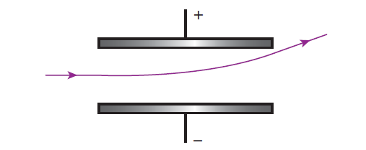
Y
X

Slide 20
Y
X
Z

Slide 21
Y
X
Z
+

Slide 22
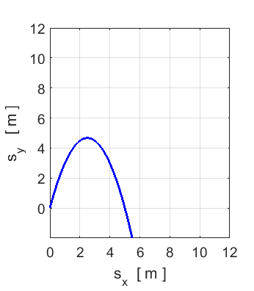
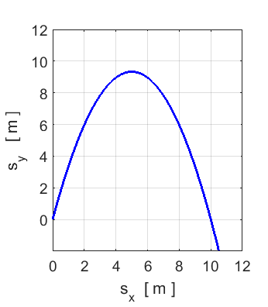
time to each max height
max height
time to each max height
max height

Slide 23
Y
+
X

Slide 24
Y
X
500 V
250 V
5 mm
U = 0 J V = 0 V
5 mm
(0,0)
- 250 V
- 500 V
proton
electron

Slide 25
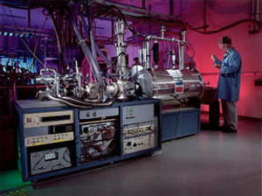
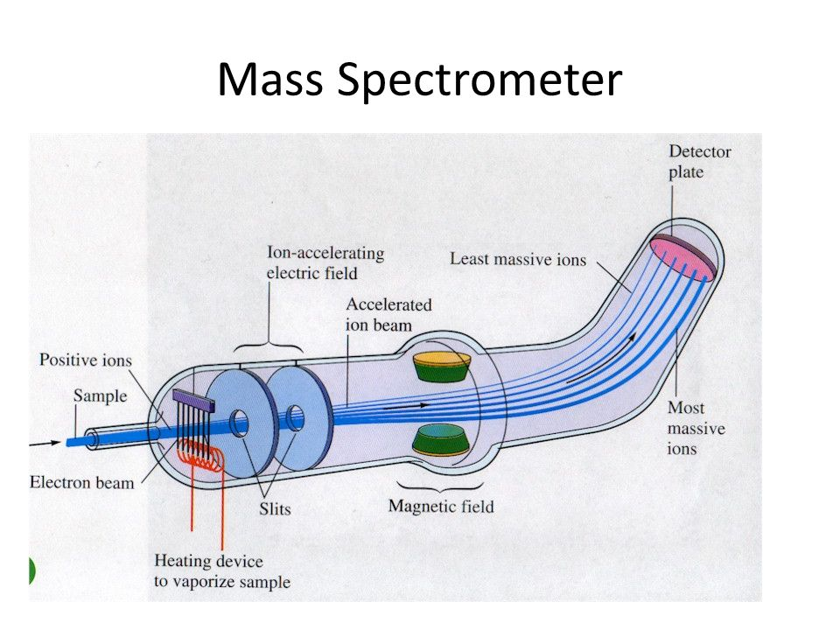
detector
ion accelerating
electric field
least massive ions
accelerated ion beam
positive ions
sample
most
massive
ions
electron beam
B-field
slits
heating element to vaporize sample

Slide 27
F_{B} < F_{E}

Slide 28
Y
X
R_{e}
anticlockwise rotation
R_{p}
clockwise rotation
radius not to scale

Slide 29
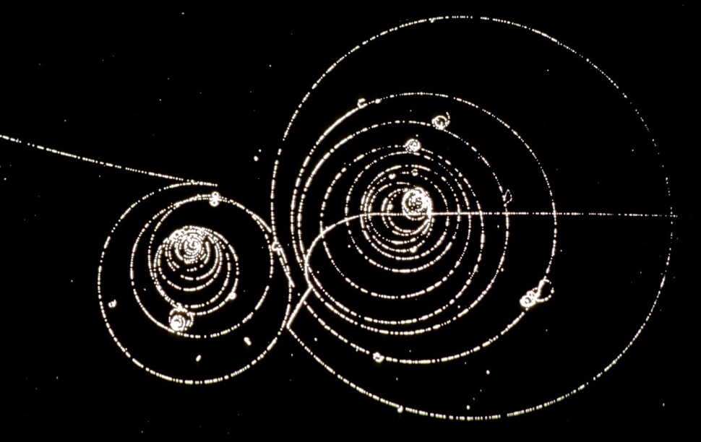
Bubble Chamber: paths of charges in magnetic field

Slide 30
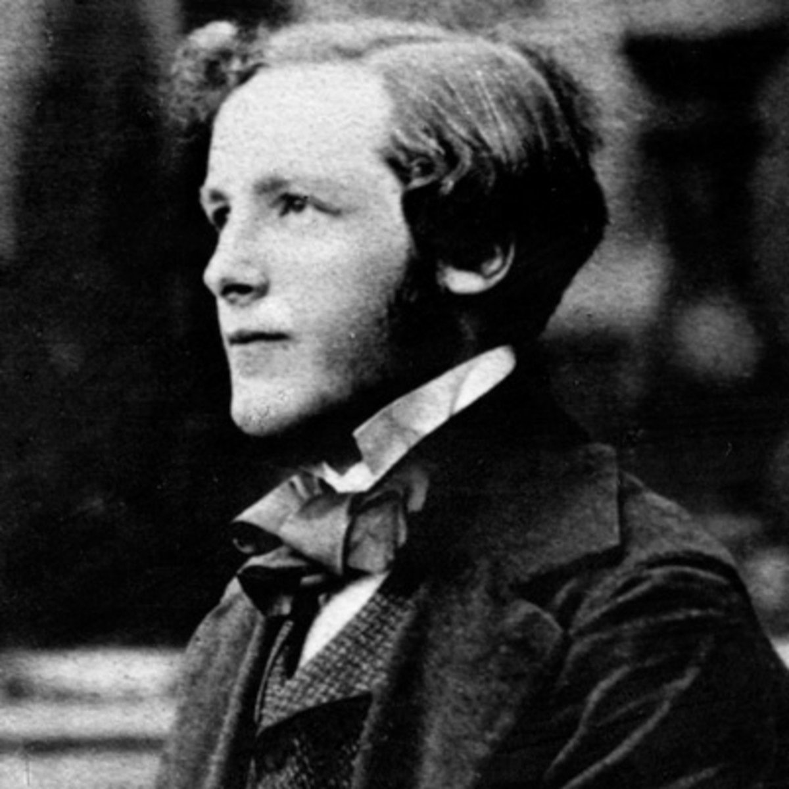
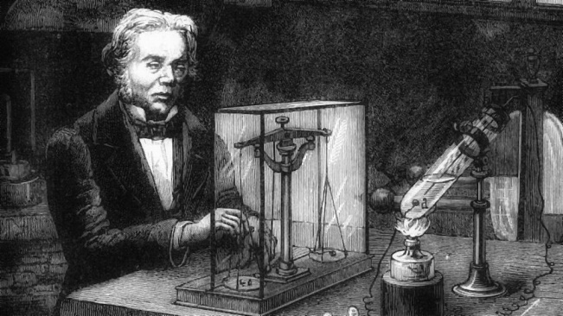
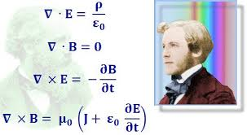
Michael Faraday
James clerk Maxwell

Slide 31
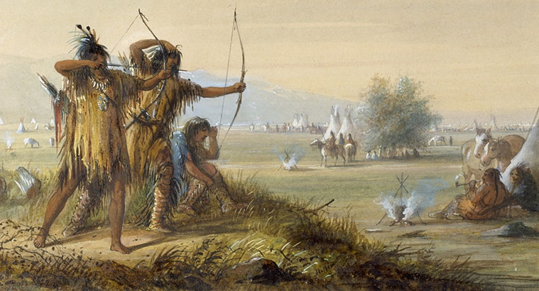

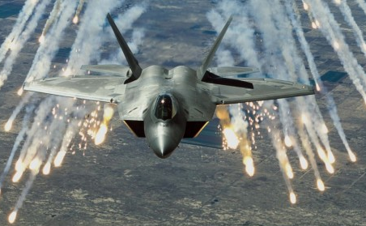

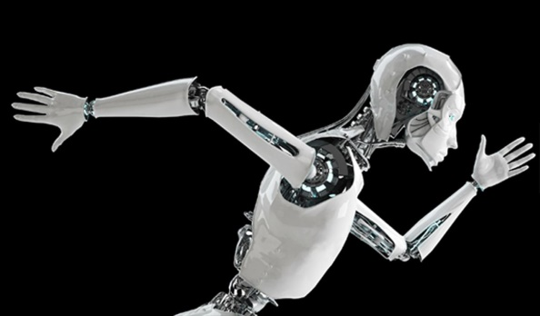
World after the work of Faraday and Maxwell

Slide 32
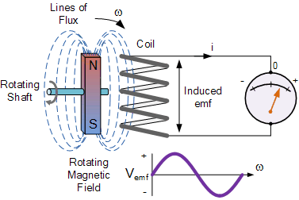
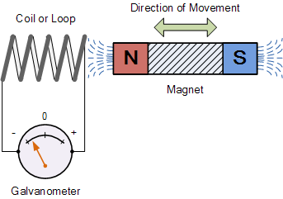
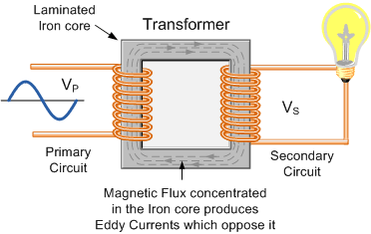
coil
rotating
shaft
coil
rotating B-field
galvanometer
laminated iron
core
transformer
primary
coils
secondary
coils
magnetic flux enhanced in iron core produces eddy currents which oppose it

Slide 33
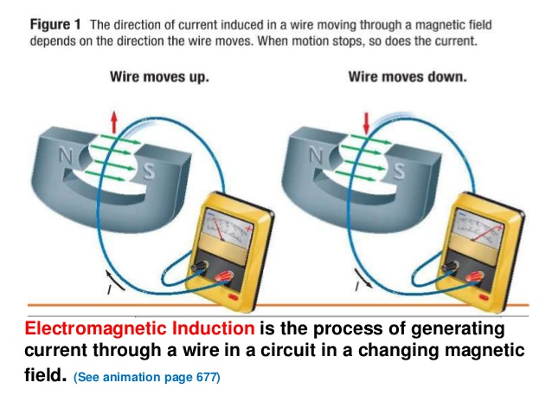
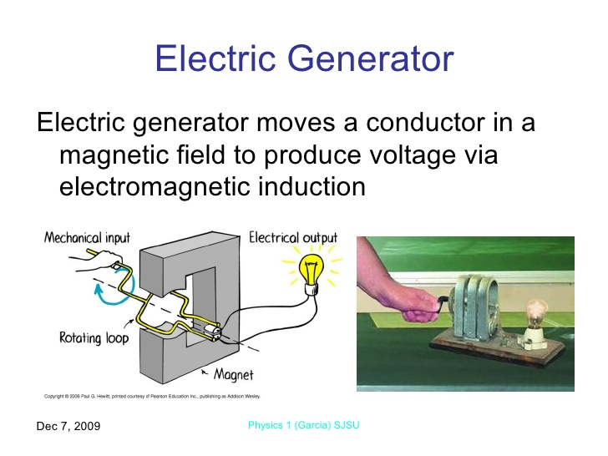
mechanical
input
electrical
output
rotating
loop
magnet

Slide 34
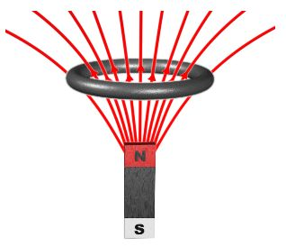
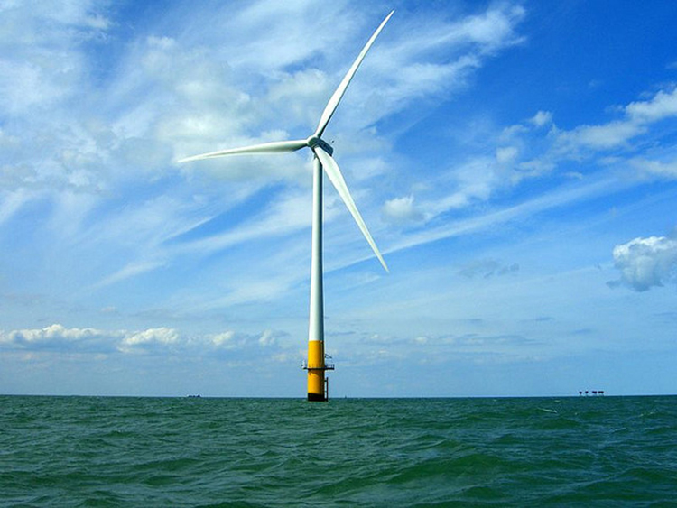
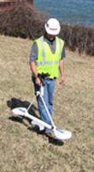
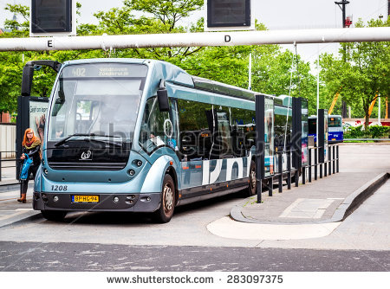
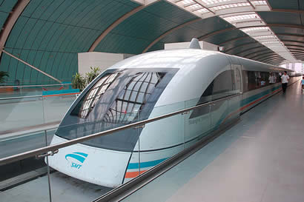
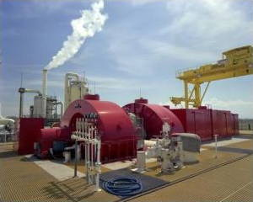
N
S

Slide 35
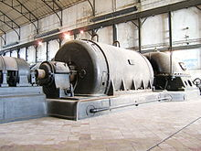
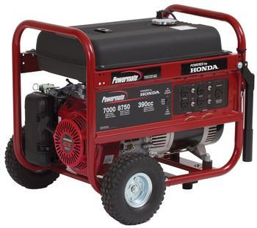
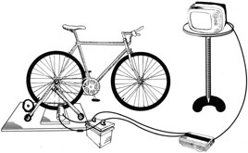
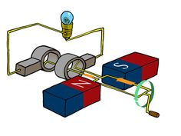
peddle power

Slide 36
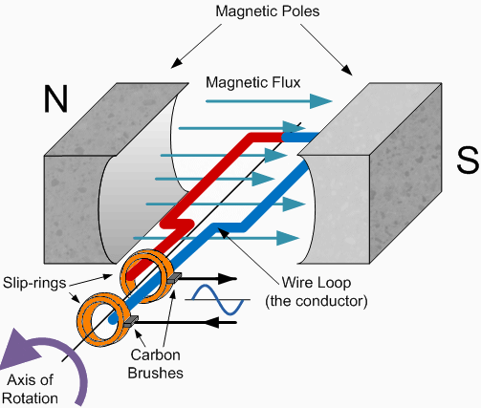

Slide 37
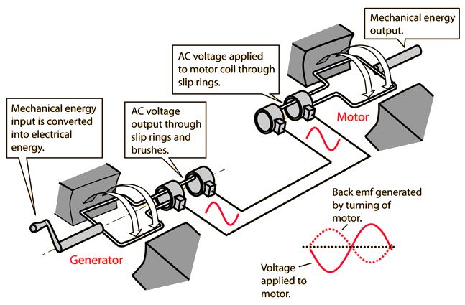

Slide 38
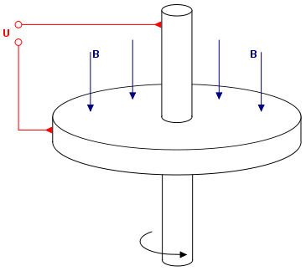
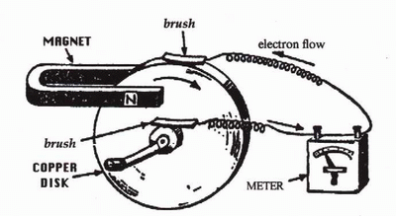
Faraday Disc dynamo – world’s first electric generator for producing a continuous DC voltage
copper disk
magnet
brush
electron flow
brush
copper
disk
meter

Slide 39
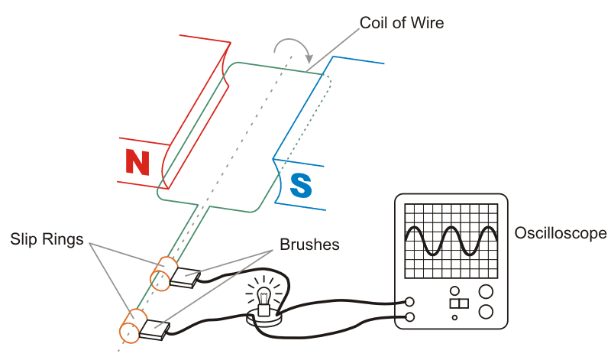
rotating coil
slip rings
brushes
CRO

Slide 40
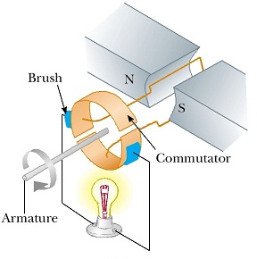
brush
commutator:
single split-ring
armature

Slide 41
coil
N = 320 turns
electromagnet

Slide 42
B [T]
0.080
0 1 2 3 4 5
t [ms]
ε [kV]
6.8
0 1 2 3 4 5
t [ms]
I [A]
136
0 1 2 3 4 5
t [ms]

Slide 43
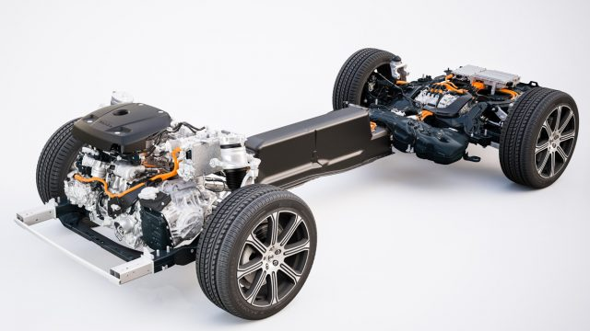
VOLVO: in the future all our cars will have electric motors

Slide 44

NO PETROL

Slide 45

electric traction motor
electronics controller
DC/DC converter
cooling system
primary battery
charge point
transmission
charger
secondary battery

